Slide 1
Navigating Uncertainty in Resilience Planning: A Comparative Analysis of Hazard Scenario Generation Methods
Zeinab Farahmandfar and Kenneth Harrison
October 2023

Slide 2

Layout
Introduction and Background
Research Objectives
Methodology
Importance Sampling
Illustrative Example
Hazard Scenario Selection

Slide 3
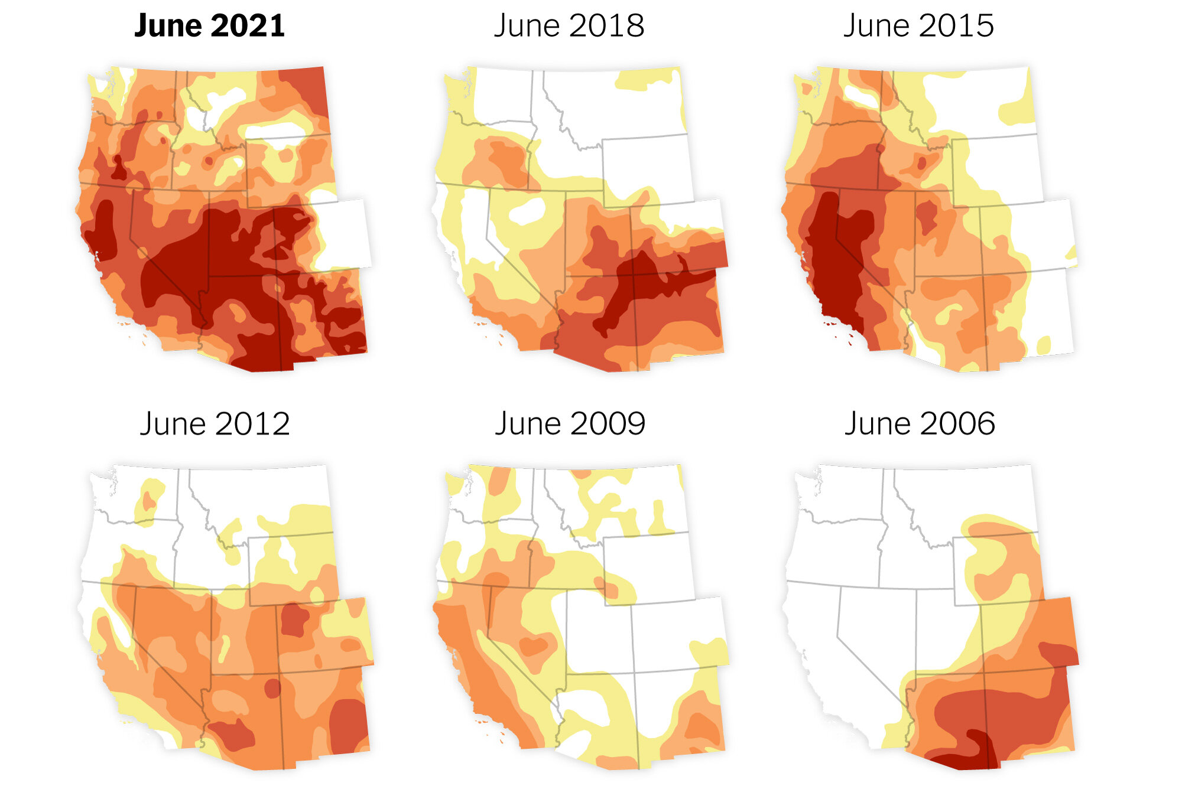
Introduction
Establishing more resilient communities is crucial in response to the alarming increase in natural disasters and unprecedented climate-related events.
Hurricane Ian caused $112.9 billion in damages
Western and Central drought/heat waves, resulted in $22.1 billion in economic losses

Slide 4
Background
Assessing community resilience involves complex factors: infrastructure, social dynamics, environment, and economy.
Uncertainty arises from multiple sources, including the nature of hazards, influencing hazard scenario selection.
Worst-case scenarios not always optimal, can lead to excessive costs.
Complexity in determining true worst-case scenario, especially for multifaceted hazards.
Simulation methods like Monte Carlo (MC) and Importance Sampling (IS) are commonly used but face challenges with rare high-impact events.

Slide 5
Research Objectives
Comparative analysis of MC and IS for hazard scenario generation in the context of community resilience.
Visualize results through an illustrative example.
Demonstrate the important role of creating scenarios when planning for resilience.

Slide 6
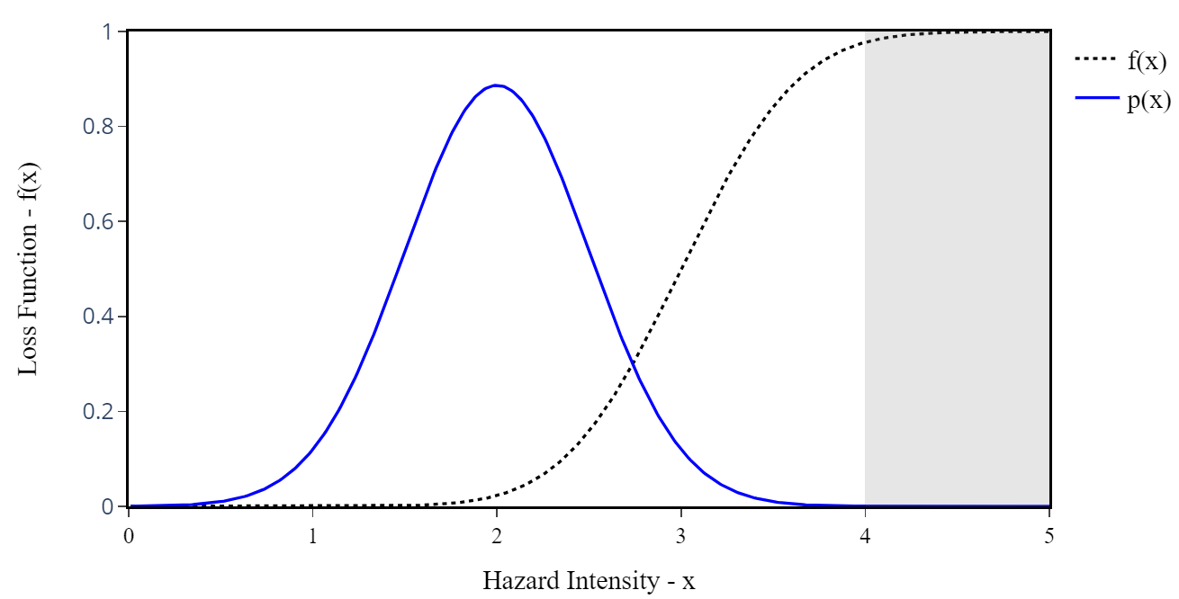
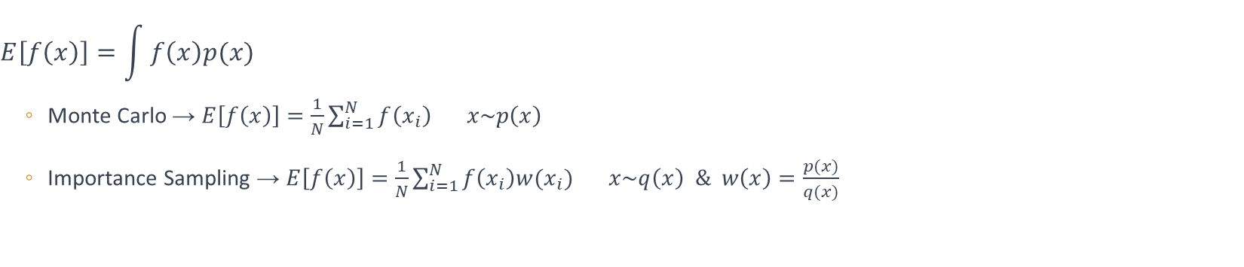
Methodology
$$E\left[f\left(x\right)\right]=\int{f\left(x\right)p(x)}$$
Monte Carlo → $E\left[f\left(x\right)\right]=\frac{1}{N}\sum_{i=1}^{N}{f\left(x_{i}\right)} x\sim p\left(x\right)$
Importance Sampling → $E\left[f\left(x\right)\right]=\frac{1}{N}\sum_{i=1}^{N}{f\left(x_{i}\right)w(x_{i})} x\sim q\left(x\right) \& w\left(x\right)=\frac{p(x)}{q(x)}$

Slide 7
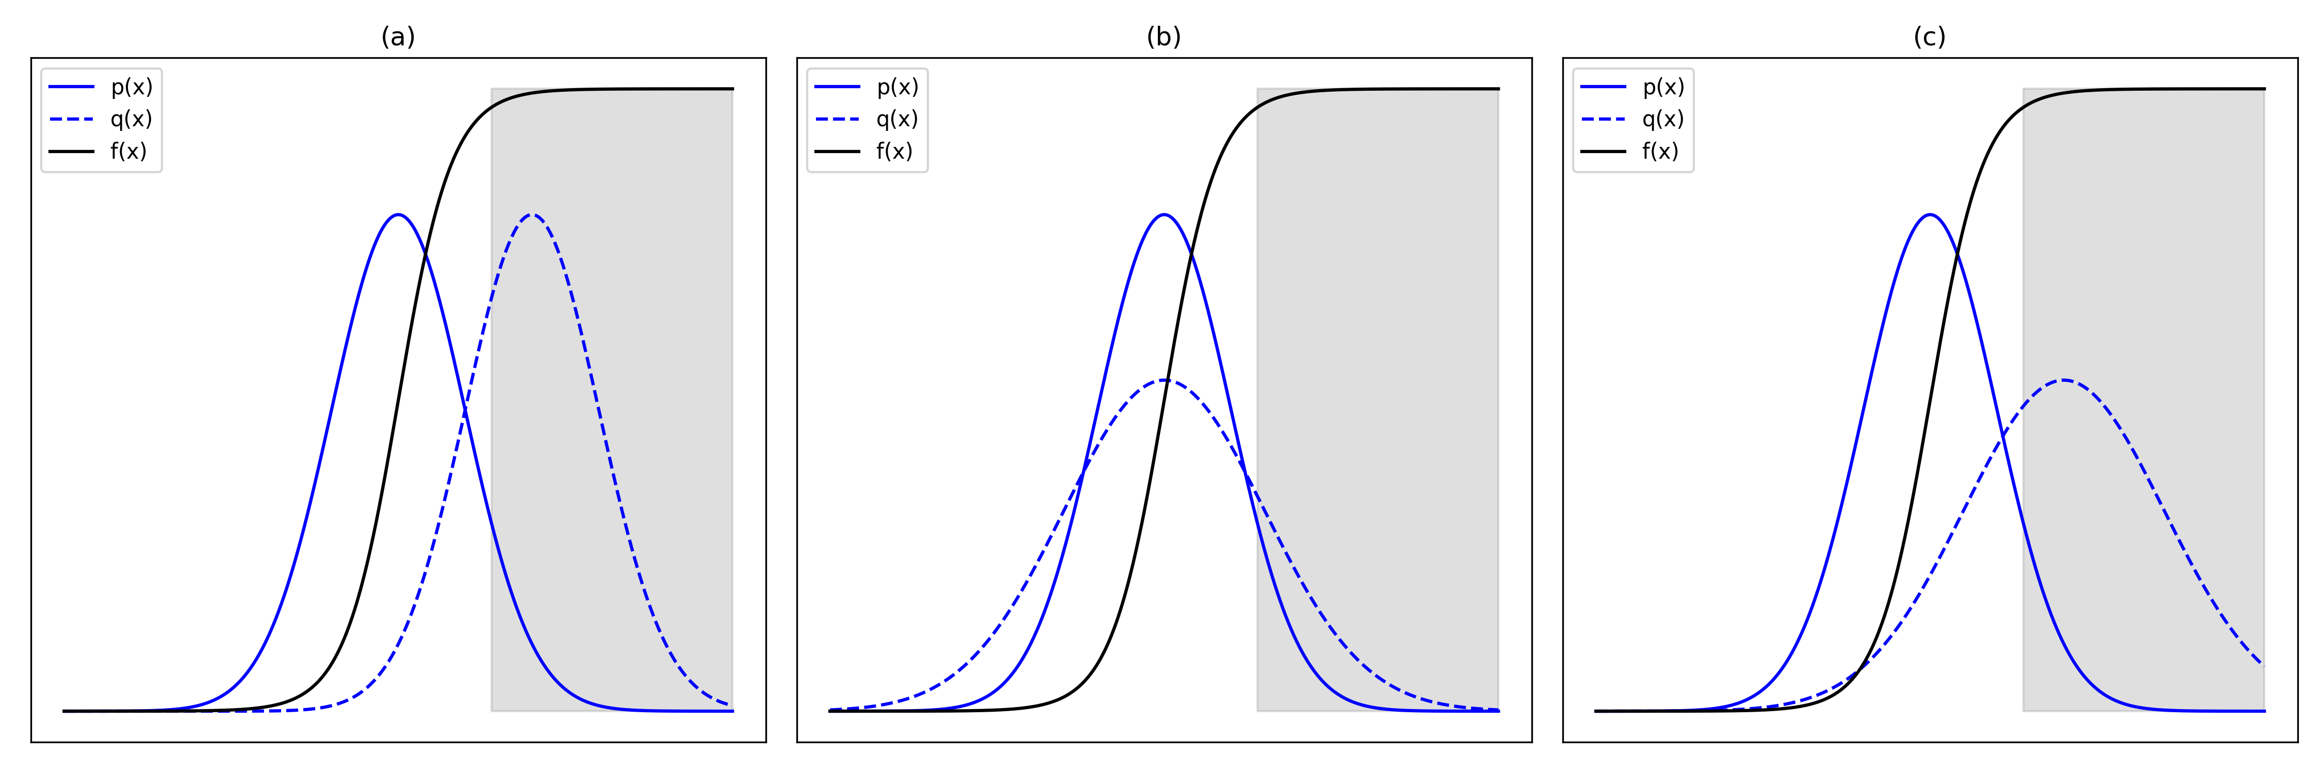
Importance Sampling
Conventional Importance Sampling
Markov Chain Monte Carlo Importance Sampling
(a) mean translation (MT), (b) variance scaling (VS), and (c) their combined application in one dimension
Sample from MCMC algorithm
Fit KDE to MCMC samples
Regenerate samples from the fitted KDE
Notes:
MCMC involves generating new samples from a proposal distribution and accepting or rejecting them based on a ratio of the proposed sample’s probability to that of the previous sample

Slide 8
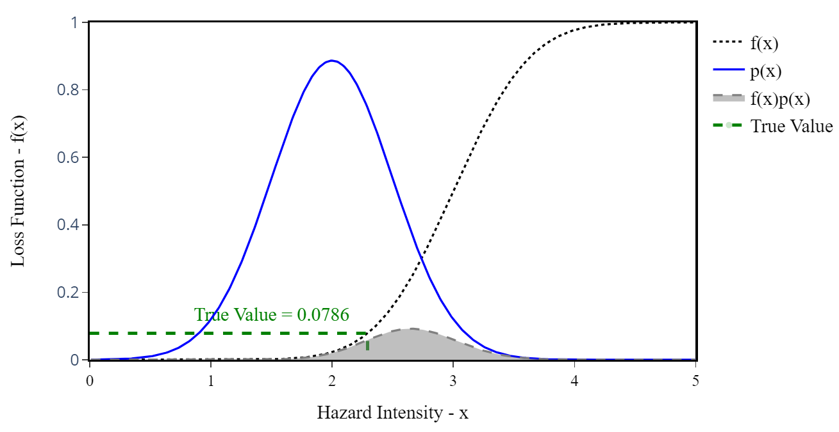
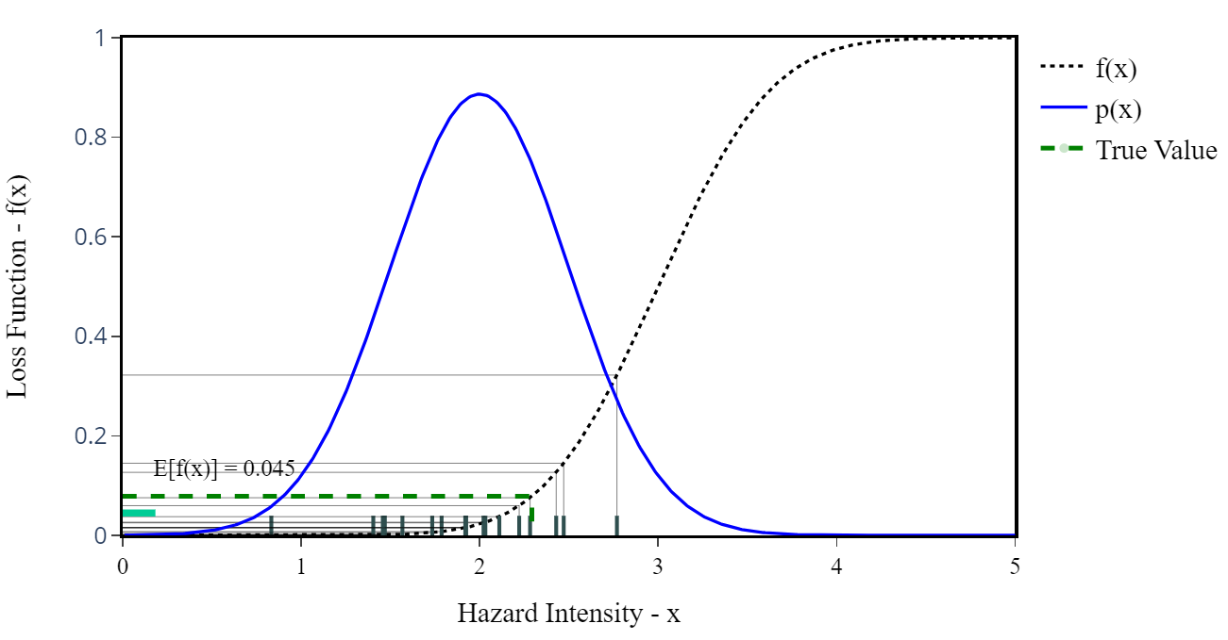
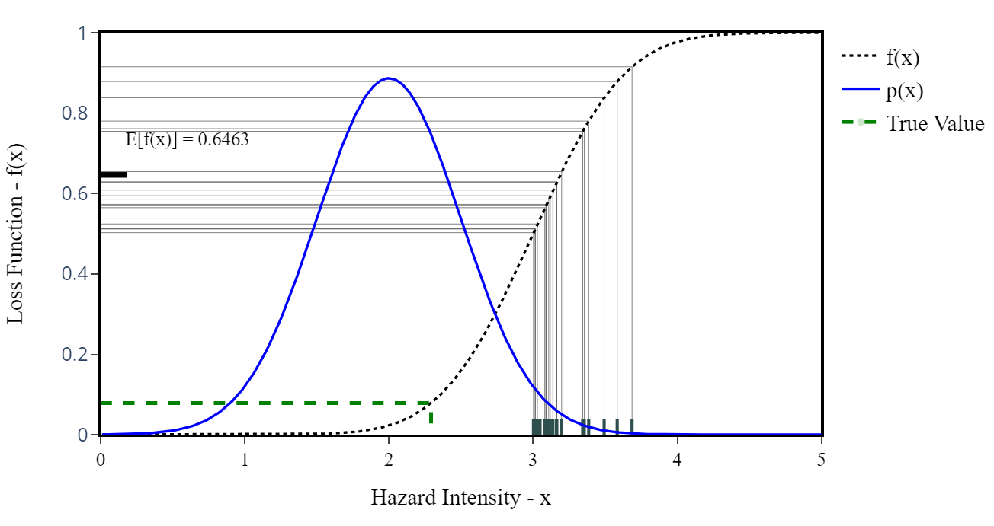
Illustrative Example - MC

Slide 9
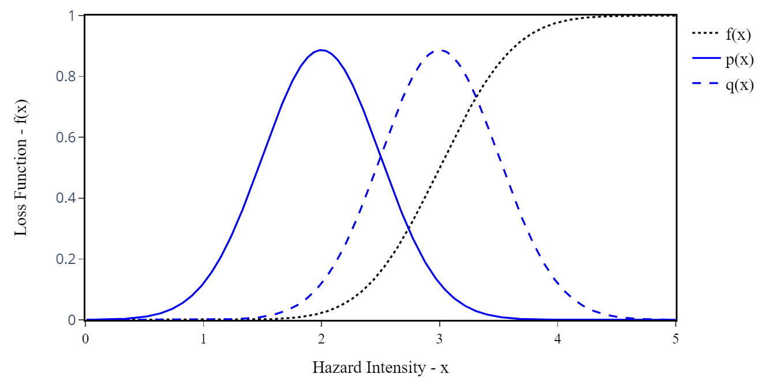
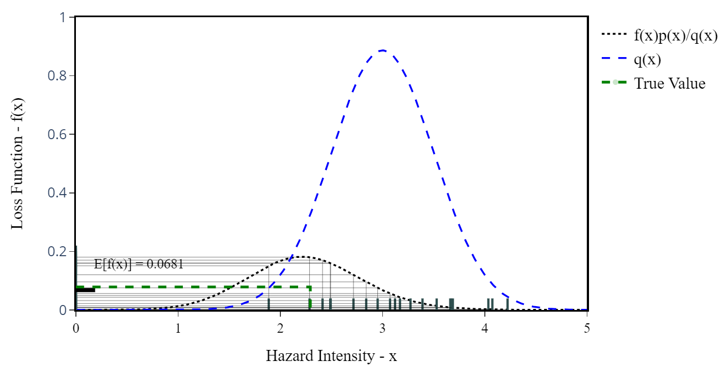
Illustrative Example - IS

Slide 10
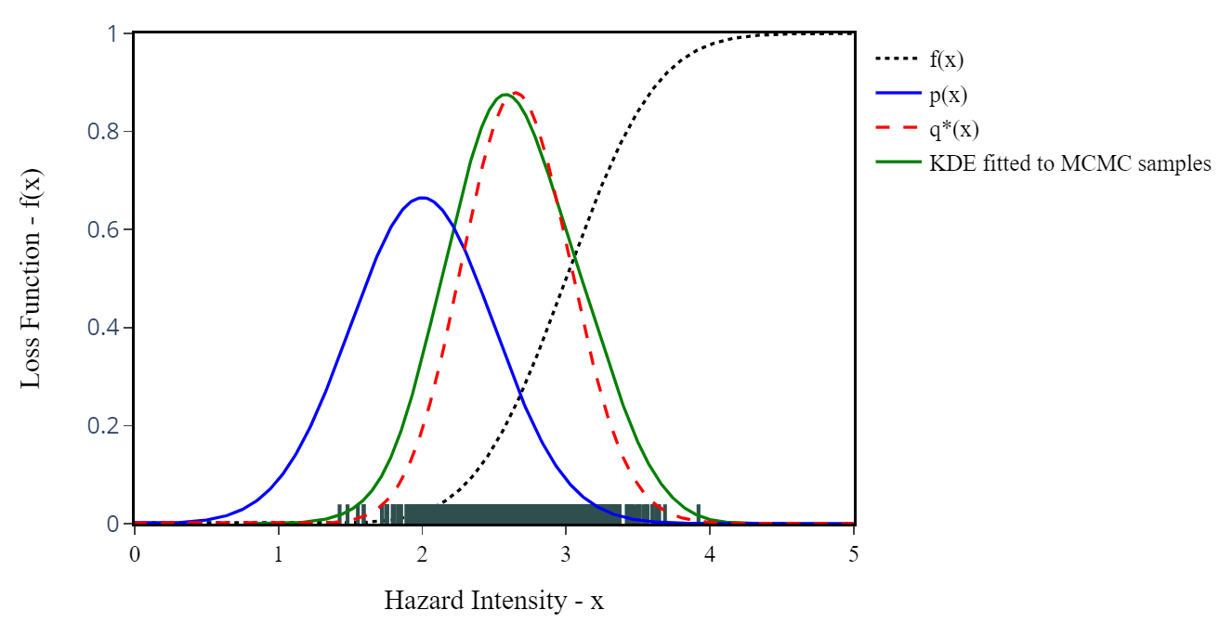
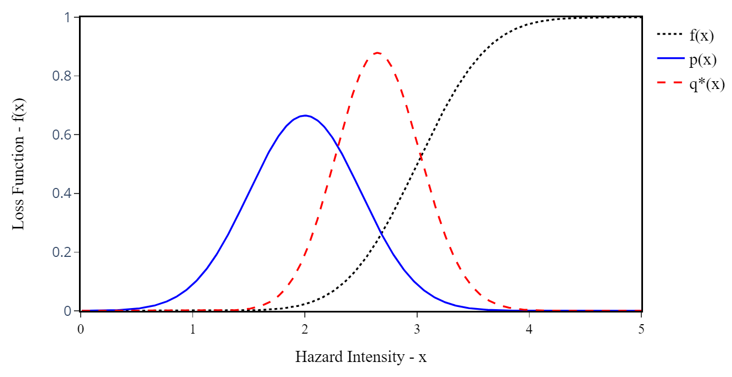
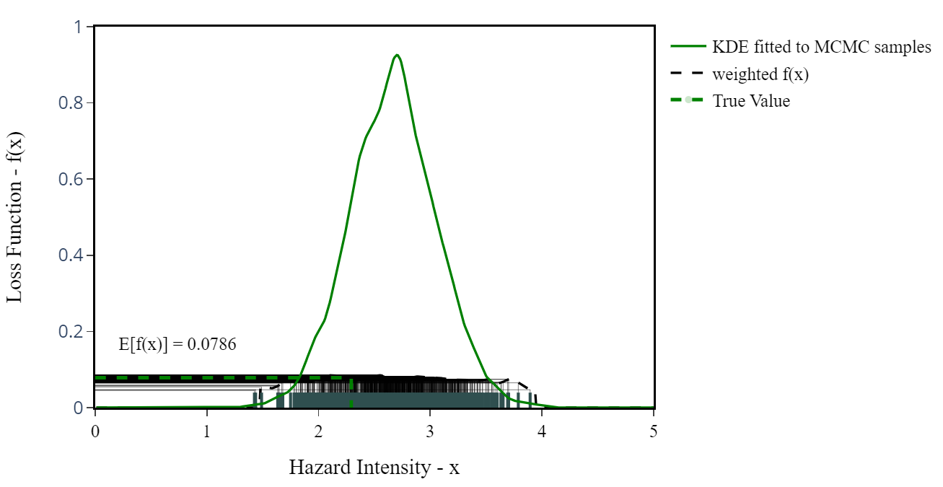

Markov Chain Monte Carlo Importance Sampling
$$q^{∗}(x)=\frac{f\left(x\right)p(x)}{\int{f\left(x\right)p(x)}}$$

Slide 11
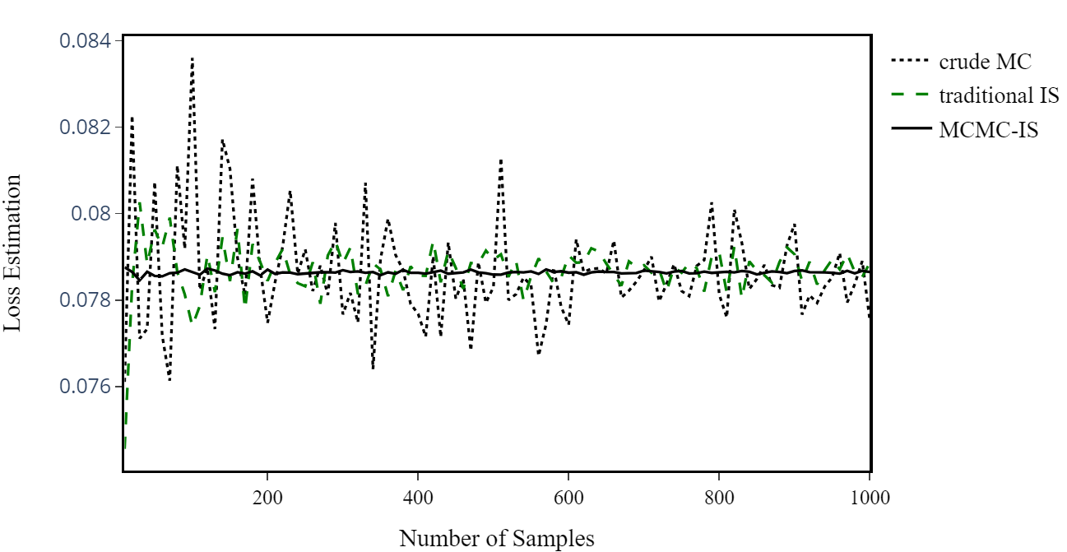
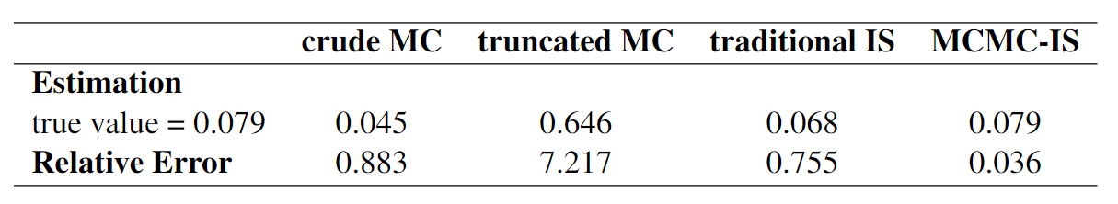
Comparative Results
Notes:
The relative error measures the percentage difference between the estimated value and the true value

Slide 12
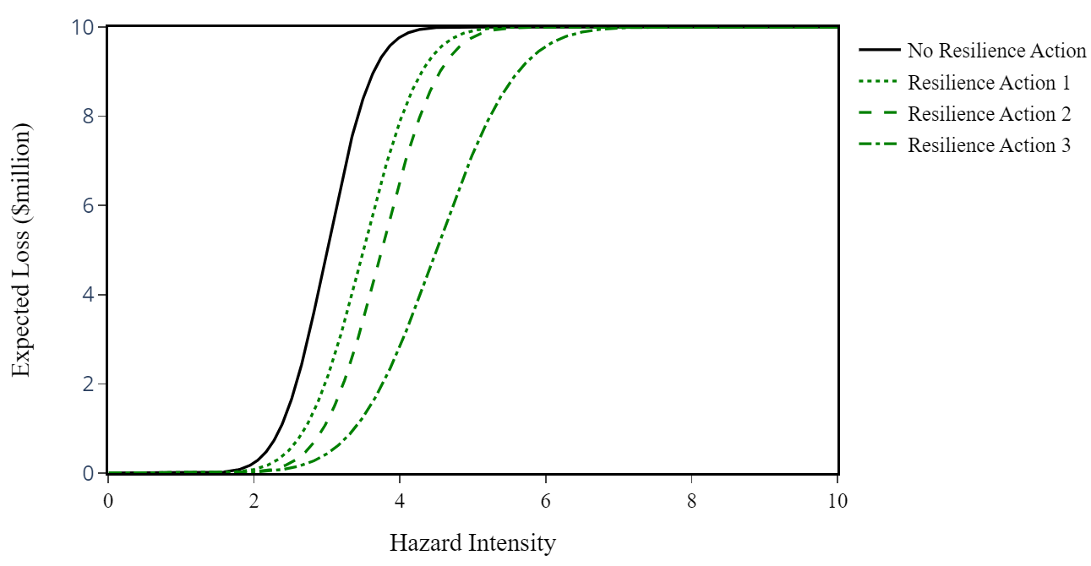
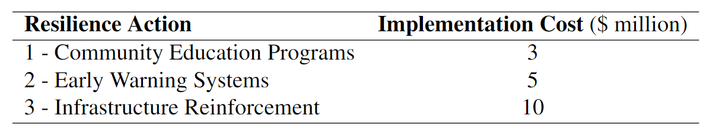
Hazard Scenario Selection
Three tailored resilience actions addressing specific vulnerabilities

Slide 13
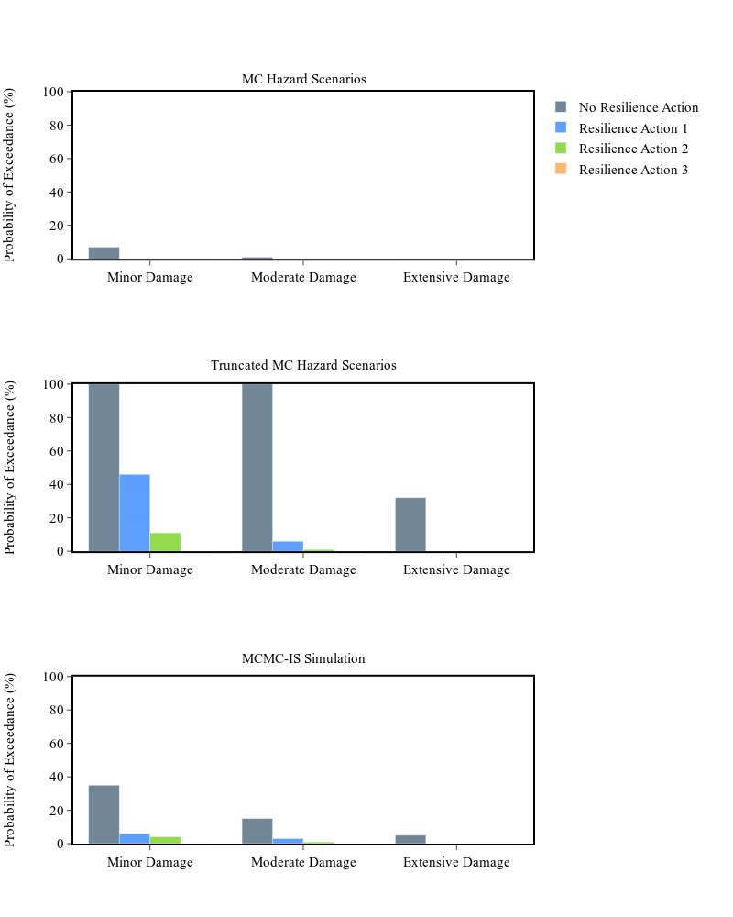
PoE of Damage States
Cost thresholds:
$2 million for minor damage
$5 million for moderate damage
$8 million for extensive damage.
Notes:
In decision-making, especially in resilience planning, understanding PoE is paramount. It helps us anticipate the probabilities of different levels of damage – minor, moderate, or extensive – given specific scenarios. This knowledge empowers us to make informed decisions. For instance, if we know there's a high PoE for extensive damage under certain conditions, we can strategically allocate resources and design interventions to mitigate that risk.

Slide 14
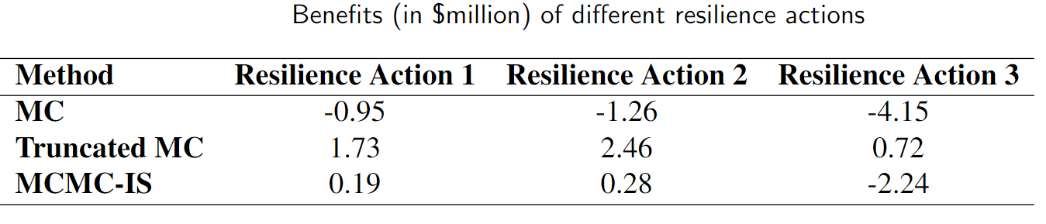
Cost-Benefit Analysis

Slide 15
Conclusions
Impact of Sampling Method: Our analysis highlighted the significant impact of the chosen sampling method on the accuracy of hazard scenario representation, directly shaping community resilience strategies.
Limitations of Crude MC: The Crude MC approach, although widely used, exhibited limitations in capturing the complexities of intricate hazards, revealing challenges in real-world applications.
Remarkable Accuracy of IS Method: In contrast, the IS method, especially the MCMC-IS technique, demonstrated exceptional accuracy in representing intricate risk factors. This precision is crucial for confident decision-making in resilience actions.
Recommendations for Future Research: We recommend future research to focus on refining methods for selecting representative hazard scenarios. This refinement should consider diverse and dynamic factors like climate change, population growth, and technological advancements.

Slide 16
Thank You!

